Slide 1
Receivables and Inventory
Chapter 6
ACT 205 – Fundamentals of Accounting

Slide 2
ACT 205 – Fundamentals of Accounting
Chapter 1: Introduction to Financial Statements
Chapter 2: A Look at Financial Statements & Financial Statement Analysis
Chapter 3: The Accounting Information System
Chapter 4: Accrual Accounting Concepts
Exam 1
Chapter 5: Fraud, Internal Control, and Cash
Chapter 6: Recording and Analyzing Merchandising Transactions, A/R, Inventory
Chapter 7: Long-Lived Assets
Exam 2
Chapter 10: Managerial Accounting
Chapter 11: Cost-Volume-Profit
Chapter 13: Budgeting
Chapter 16: Planning for Capital Investments
Exam 3
Chapter 8: Liabilities and Equity
Final Exam

Slide 3
Part 1: Financial Accounting
Income Statement
Revenues
Less Expenses
= Net Income
Other Comprehensive Income
Statement of
Changes in Shareholders’
Equity
Common Stock
Retained
Earnings
Statement of
Cash Flows
Operating
Investing
Financing
Balance Sheet
Assets = Liabilities + Shareholders’ Equity
Cash Chp. 5
Accounts Receivable Chp. 6
Inventory Chp. 6
Long Lived Assets Chp. 7
Liabilities Chp. 8
Equity Chp. 8
The Accounting Process – Chapters 1,2,3,4

Slide 4
Part 2: Managerial Accounting
Terms
Chapter 10
Cost-Volume-Profit Analysis
Chapter 11
Budgetary planning
Chapter 13
Net Present Value
Annual Rate of Return
Chapter 16
Tools to assist management in decision making and evaluating those decisions

Slide 5
Optional BONUS
Three potential Bonus assignments:
Book: Make it Stick, by Brown, Roediger III, McDaniels
Each essay is to be one page single-spaced typed and is worth max. 3 bonus points. Each essay needs to answer two questions:
What do you think are the “Big Ideas” from the assigned reading?
How might you implement some of the ideas?
No late assignments will be accepted. You may turn in essays early. Print and bring to class.
Essay #1 chapters 1-3 Due Tuesday 2/12
Essay #2 chapters 4-6 Due Tuesday 3/12
Essay #3 chapters 7-8 Due Tuesday 4/9

Slide 6
Learning Objectives
To account for Receivables
To determine cost of Inventory
To prepare a multiple-step Income Statement
To analyze gross profit margin and profit margin ratios

Slide 7
Terms To USE – fill in as we go through lecture
Bad debt Expense -
Allowance for doubtful accounts -
Sales returns and allowances -
Write-off of A/R -
FIFO -
LIFO -
Average Costing of Inventory -

Slide 8
Accounts Receivable
Recorded when a business sells a product or services to customers ON ACCT
Most companies don’t expect to collect the full amount. Net realizable value is the amount expected to be collected
Net Realizable value = A/R balance – allowance for doubtful accounts balance

Slide 9
Accounts Receivable - The Allowance Method
Accounts Receivable is recorded on Balance Sheet at:
Net Realizable Value (NET A/R)
(The amount of cash we expect to collect)
The Allowance Method, has 3 E’s:
Estimate bad debt expense (uncollectible expense)
Entry to record estimate
Entry to record Write-off specific accounts

Slide 10
Problems
I do: P6-7, page 252
You do: Chapter 6 Problems: P6-6 page 251

Slide 11
Inventory
What is Inventory?
  What a company intends to sell to customers
  Current asset on the Balance Sheet -Ending Inventory is what is not sold yet
  What is Cost of Goods Sold?
  the Cost of the inventory sold

Slide 12
Merchandising Company - Income Measurement
Not used in a Service business.
Sales
Revenue
Less
Cost of
Goods Sold
Equals
Gross
Profit
Less
Operating
Expenses
Net
Income
(Loss)
Cost of goods sold is the total cost of merchandise sold during the period.
Equals
LO 1

Slide 13
Inventory
Merchandising Company
Manufacturing Company
One Classification:
  Merchandise Inventory
Three Classifications:
  Raw Materials
  Work in Process
  Finished Goods
▼ HELPFUL HINT
Regardless of the classification, companies report all inventories under Current Assets on the balance sheet.
LO 2

Slide 14
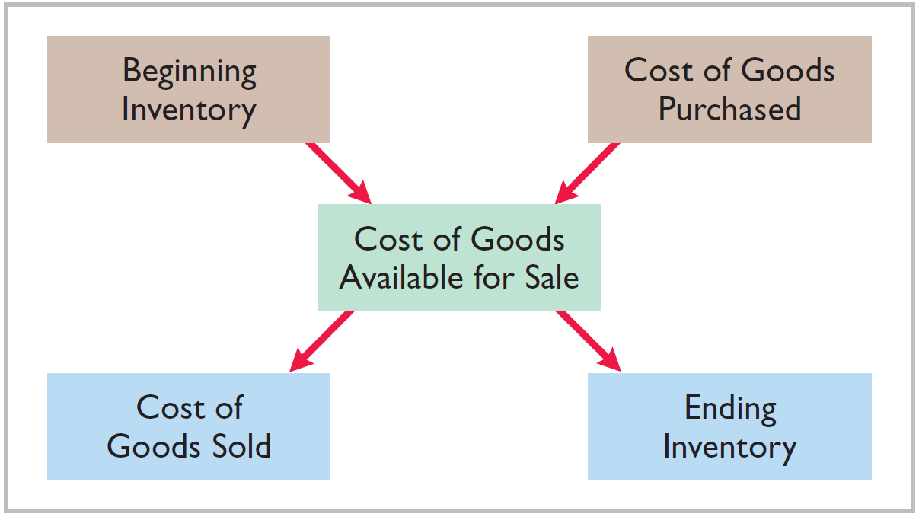
FLOW OF COSTS of Inventory
Companies use either a perpetual inventory system OR a periodic inventory system
LO 1

Slide 15
FLOW OF COSTS - Perpetual System
  Two transactions when you sell inventory:
  #1 Record the sale
  #2 Reduce inventory
LO 1

Slide 16
FLOW OF COSTS - Periodic System
  Does NOT keep detailed records of inventory;
  1 Transaction only at time of sale
  Cost of goods sold determined by count at the end of the accounting period
  Calculate Cost of Goods Sold:
Beginning inventory $ 100,000
Add: Purchases, net 800,000
Goods available for sale 900,000
Less: Ending inventory 125,000
Cost of goods sold $ 775,000
LO 1

Slide 17
Inventory Costing Methods
  How do we cost inventory?
  Four cost flow methods:
  Specific identification
  First-in, first out (FIFO)
  Last-in, first out (LIFO)
  Weighted-Average cost

Slide 18
Inventory Costing Methods
  Four possible ways, each GAAP:
  Specific identification – unique items
  First-in, first out (FIFO) – assume for costing purposes that first items in, first out to COGS
  Last-in, first out (LIFO) – assume for costing purposes that the last items in, are the first out to COGS
  Weighted-Average cost – assume for costing purposes mixture
    Weighted average = Total Cost of goods available for sale/
    Total # of units Available for sale

Slide 19
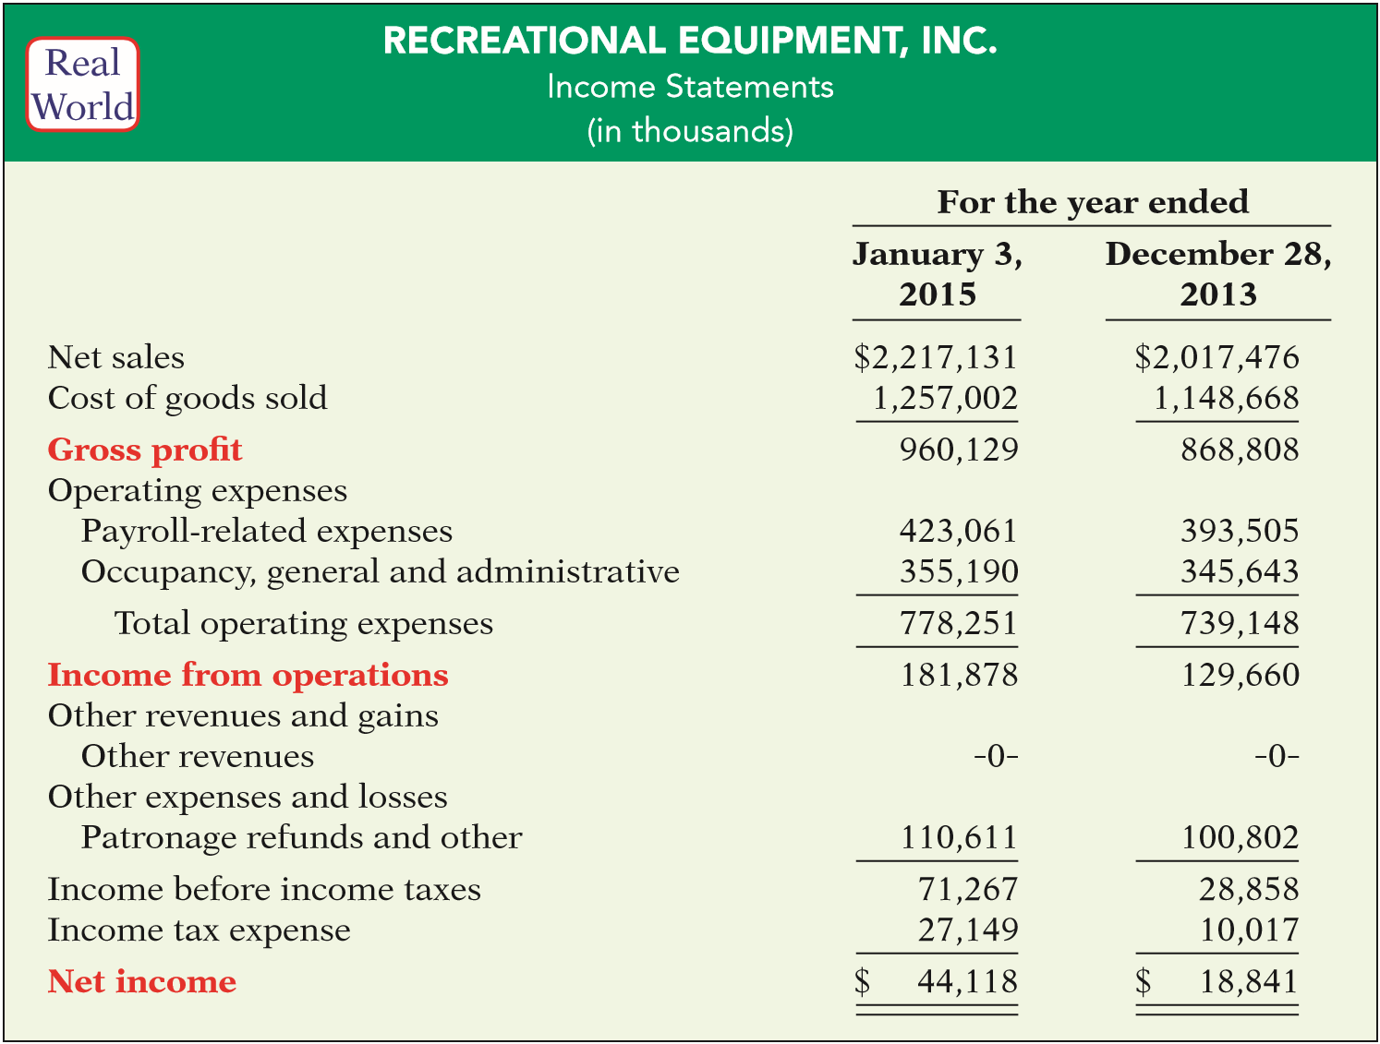
MULTIPLE-STEP INCOME STATEMENT
Key Line Items
LO 4

Slide 20
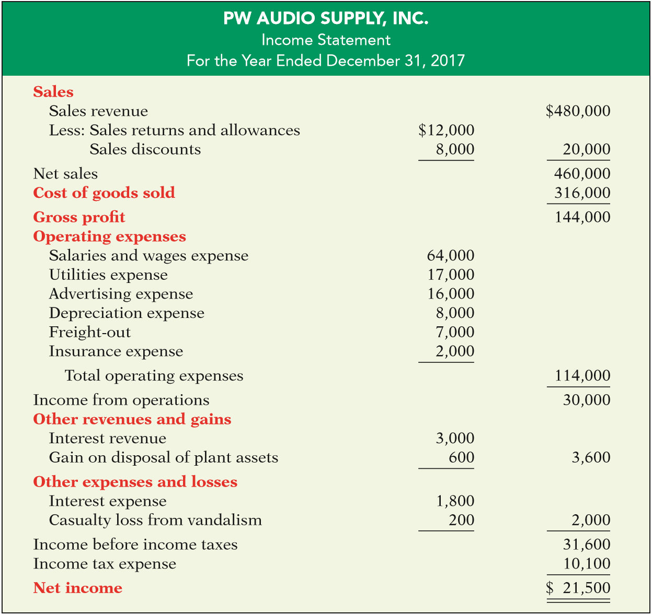
MULTIPLE-STEP
Key Items:
Sales
LO 4

Slide 21
MULTIPLE-STEP
Key Items:
Sales
Gross Profit
Operating Expenses
Nonoperating Activities
ILLUSTRATION 6-19
LO 4

Slide 22
Problems
I do: Chapter 6 Problems: P6-2, P6-3
You do: Chapter 6 Problems: P6-5
Adaptive Practice – Chapter 7 Due 3/11
Homework – Chapter 6 Due 3/11
EXIT TICKETS DUE AT END OF EACH CLASS

